Slide 1
Who are the key figures in Alevism?
Notes:
1. Introduce this unit by recapping what was done in KS1 (Who are the Alevis) and LKS2 (The Cemevi) and that we are now going to look at people and teachings that have influenced and inspired Alevis over the centuries.
This is a thought-provoking 3 lesson topic that may be good for the end of Y6 after SATs but can equally be covered in Y5. We hope to produce, over time, some accessible translations of important poems and hymns from the Pirs. There is room here for creative approaches to the topic, for example looking at developing cross-curricular work with English, Art and Music to express deeply held beliefs and attitudes, maybe also bringing in media images and messages about what is important in life.

Slide 2
What do you already know about Alevism?
Notes:
2. Recap! May need to jog their memories about Cem and Cemevi, then values.
Maybe showing some pictures may help to jog their memories, but this should be very brief- go back to previous pp slides KS1 and LKS2

Slide 3
1 Why is Ali important in Alevism?
Notes:
3. Ask pupils who is important in their lives, who influences them.
How are they a good influence on them?
Can they think of famous people who are a bad influence on others?
What makes someone a good or a bad influence?
Discuss the importance of role-models

Slide 4
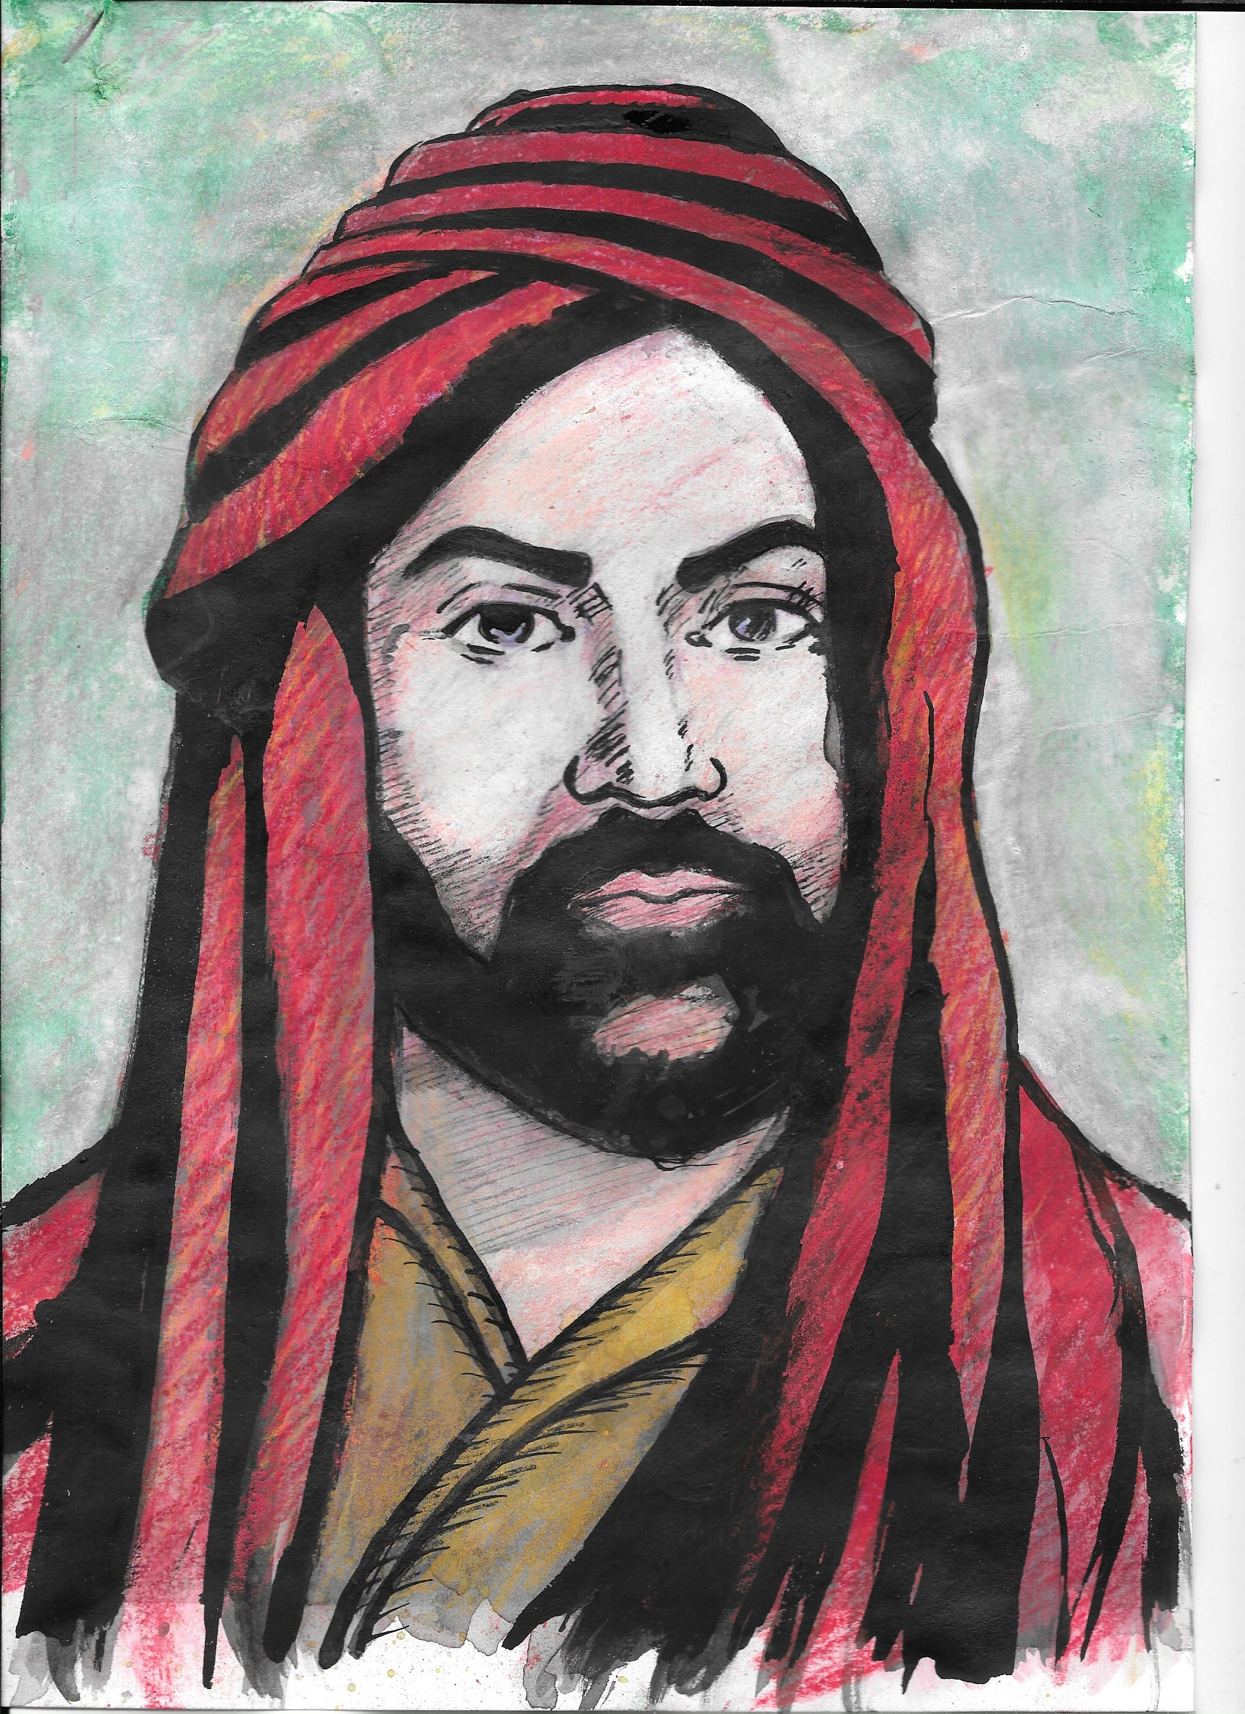
Who is Ali?
Alevis believe Ali is the most important figure in Alevism. Ali was prophet Muhammet’s (Muhammad) cousin. He was also married to Muhammet's daughter.
Notes:
4. When Muhamet died, Ali was the fourth person, in Islamic tradition. to be given permission to help lead the Islamic religion.
NB this could raise the question whether Alevism is part of (a sect in) Islam.
It is advisable NOT to give a definitive answer here, as opinion is divided.
Simply state this as a fact, and that even among the Alevis themselves, some identify as a separate religion and others as a sect of Shi’a Islam.
Point out that one of the things they could do is try to form their own opinion of this, based on what they know about Islam.
This is something that will be explored in greater depth in KS3

Slide 5
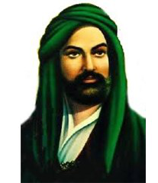
What sort of person do you think he was?
What makes you think this?
Notes:
5. Explore his facial expression with focus on eyes in particular. Maybe need to tease out responses by asking ‘Does he look like he would be threatening?’ Does he look like someone who would run away and be easily frightened? etc. discuss responses.
How do we judge people?
What qualities should we admire in people?

Slide 6
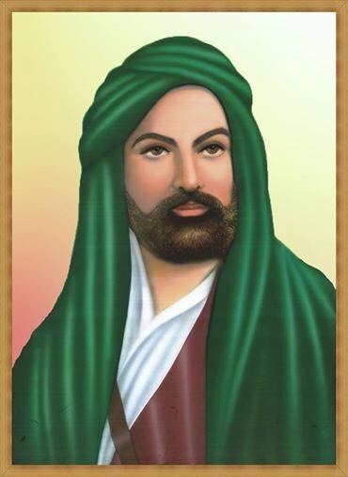
Ali believed that knowledge is very important.
He believed that people should have good knowledge.
What do you think is ‘good’ knowledge?
Notes:
6. Is there a difference between knowledge and belief? Can they give examples? You may want to help them here by stating beliefs as facts – eg ‘There is a God’ compared to ‘There is a table’. Which is fact and which is belief? For real challenge, you could ask whether knowledge can be both belief and fact (eg believing you can trust someone could also be a fact).
What is knowledge? Is it just facts? If I say I know someone, does that mean simply that I know facts about them, or is there more involved?
Is there any such thing as bad knowledge?
What makes knowledge good or bad, if anything? Is it the knowledge that is good/bad?
Take pupils’ responses and help the class to develop on them.
How has knowledge changed over time? Should this influence what we believe? Is it right to hold beliefs that go against clear knowledge?
Ali believed that it is very important that people adapt their beliefs to the present day. Why do you think this is?

Slide 7
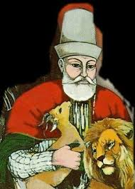
This is a picture of Haci Bektas Veli and he also believed in the importance of knowledge.
’Without science(knowledge), the end of the path would be dark (Haci Bektas Veli)
It means that Alevi faith and beliefs should be based on reason, experience and evidence.
Notes:
7. What counts as good evidence? One pupil might believe a teacher is a good teacher and another pupil think she is a poor teacher – based on the same evidence. How do we decide who is right? Ask pupils whether ‘anything goes’ or whether there are some beliefs that are clearly wrong, and if so, why?

Slide 8
Task Diamond 9 What is most important in life?
1
2
2
3
3
3
4
4
5
Notes:
8. This could be done in pairs or groups.
Discussion afterwards – keep as open as possible. Ask for reasons and examples to back up opinions.
Some possible stimulus questions:
Is there anything they think is missing that they would want in the D9? If so, what would they takeout?
Is there anything that holds life together?
Are the physical things enough on their own?
How do we know what is most important in life?

